Slide 1
Glow 2019
Frightened Flowers
Davey Hurkmans, Geert Boer, Jane Buzykina & Vincent Venhuizen

Slide 2
KNOWN PROBLEMS & FIXES
Motor - Problems for demo
Frame - Needs to be built more stable
LED strips - Couldn't order new ones (re-used old one's)
Animations - Require fine tuning

Slide 3
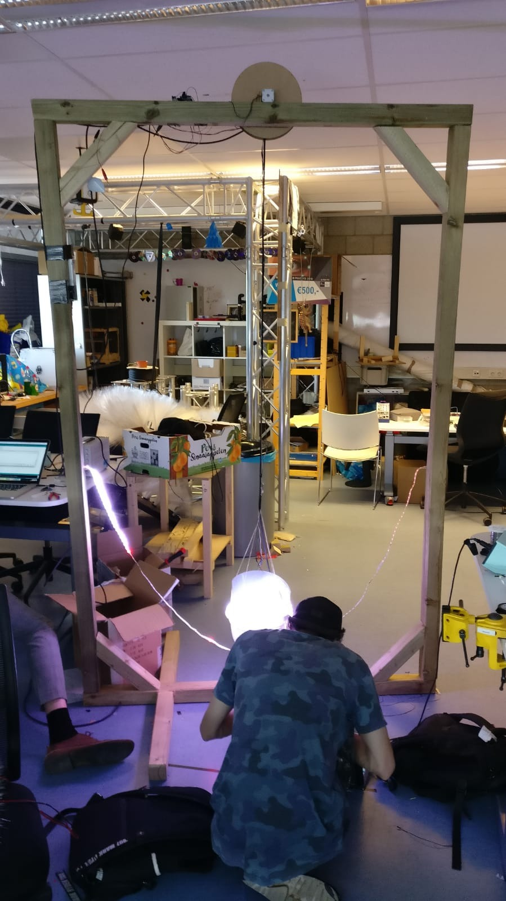
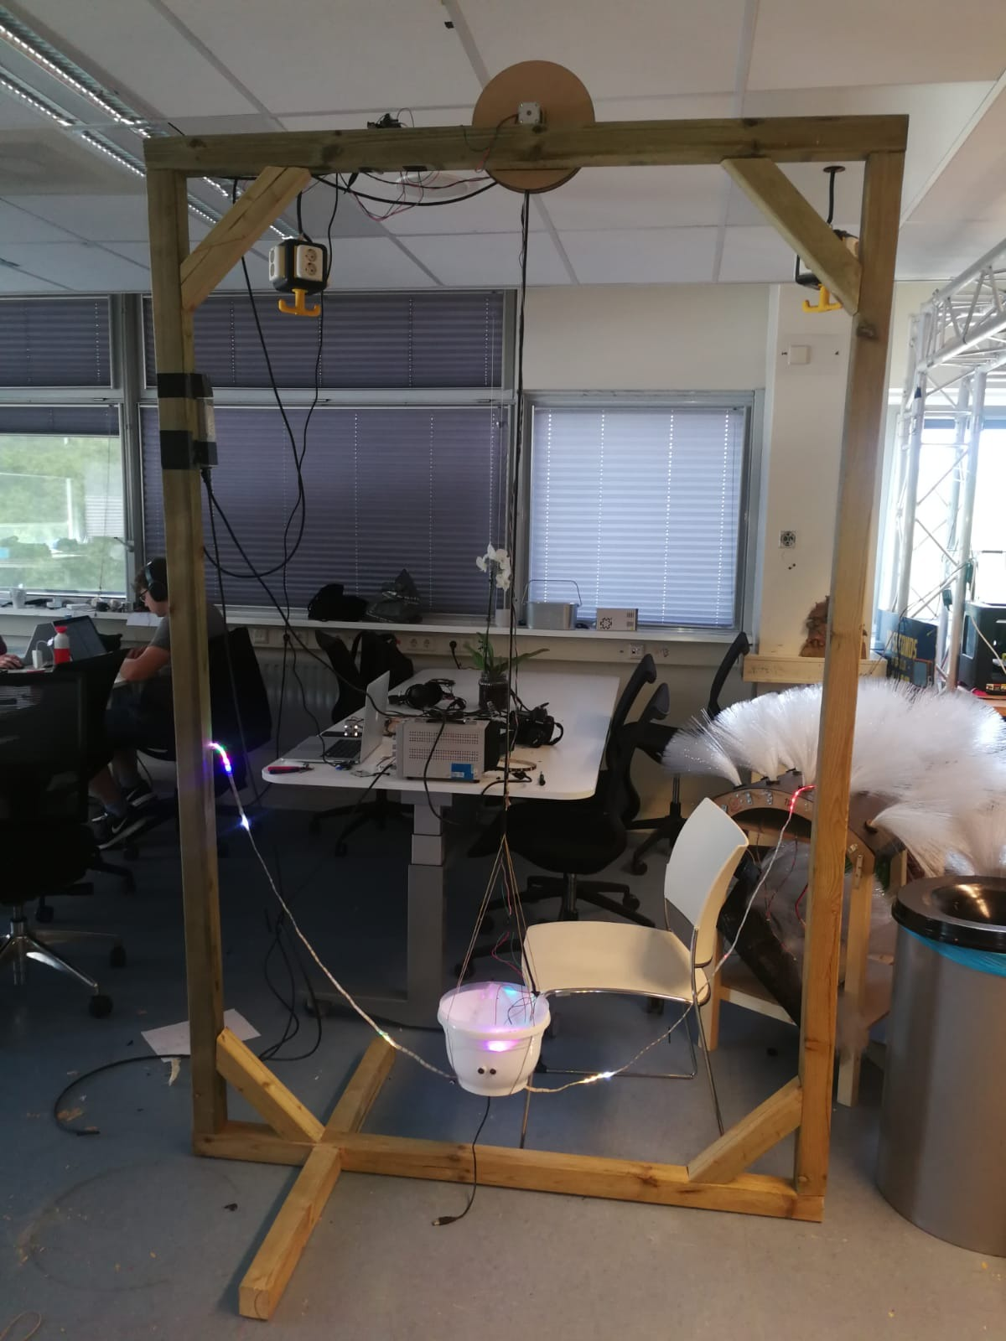
DEMO
We start with a small demo of our project.

Slide 4
COSTS
Wooden frame - €60 +- /per frame
LED strips 5M - €20 +- /1x
Stepper motor - €40 +- /1x
Power supply - €12 +- /1x
Flower pot - €10 +- /1x
Total per frame: €140
I.e. 7 frames: €994

Slide 5
Thanks
for listening!

